Slide 1

MATE: Multi-Attribute Table Extraction
Darshan Patel, Nancy Patel, Ajay Babu Popuri
College of Computing
Illinois Institute of Technology
1st Dec 2023
CS 520 & Data Integration, Warehousing, and Provenance
Dr. Boris Glavic

Slide 2
What is MATE?
It’s a decision-making approach involving the evaluation and comparison of alternatives across various attributes or criteria using a tabular format. This method likely includes assessing multiple factors simultaneously to determine the attractiveness or preference of different options within a structured table framework.
We use joint discovery where there is a dataset and query column that is basically the join key.
From large amount of tables, we can find the joinable tables and feed it to the machine learning model with the integrated join tables of the input dataset

Slide 3
Abstract
"MATE: Multi-Attribute Table Extraction" introduces a novel table discovery system, which addresses the limitations of existing works on indexing and retrieving joinable tables from large corpora. Current systems are restricted to unary joins, limiting their application and efficiency for prevalent datasets with composite join keys. Mate as a solution to this challenge, leveraging a novel hash-based index to efficiently discover joinable tables, even in the presence of n-ary join keys. Filtering layer (XASH) using hash function which encode Mate can prune false positives up to 1000𝑥 more effectively, leading to over 60𝑥 faster table discovery compared to existing state-of-the-art systems. MATE presents a significant advancement in the field of table discovery systems, addressing the limitations of existing approaches and providing a more efficient solution for discovering joinable tables with n-ary join keys and multi-column combinations.

Slide 4

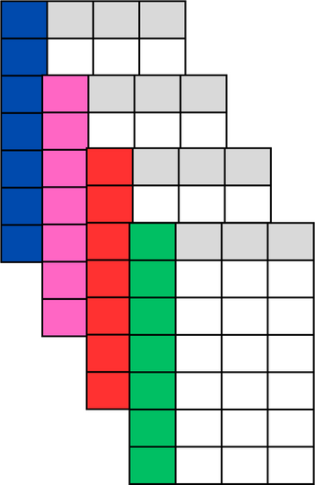
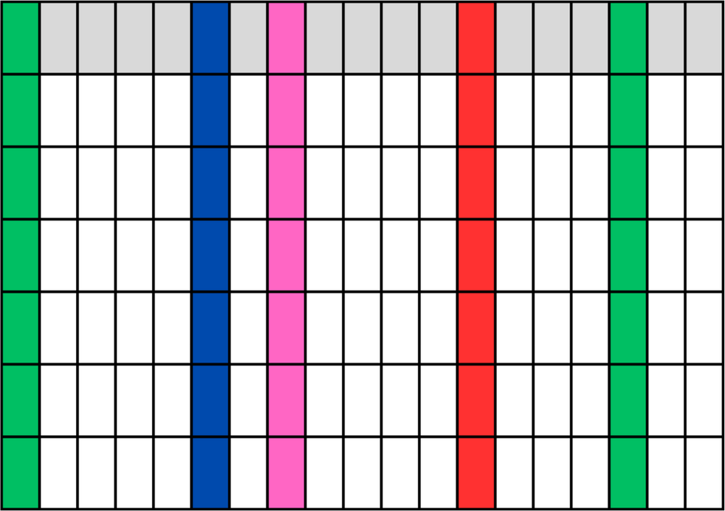
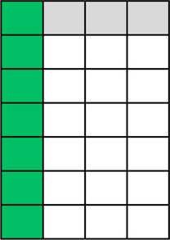
Join Discovery
Query
Column
Query
Dataset
Join
Search
Joinable
Tables
A Large-Scale Corpus of Relational Tables

Slide 5
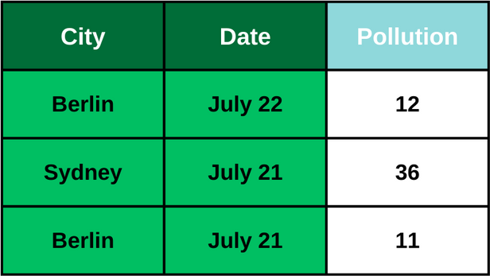
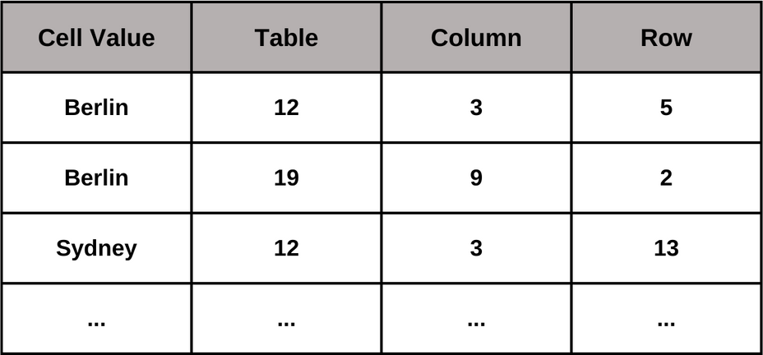
Problem
Composite (Multi-Attribute) Keys
Sample Query Table
1. Current Join Search Alg. are Single-Attribute
2. Traditional Inverted Index is Single-Attribute
Sample Inverted Index 1
3. Multi-Attribute Solution is Needed

Slide 6
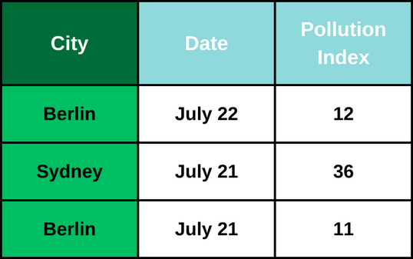
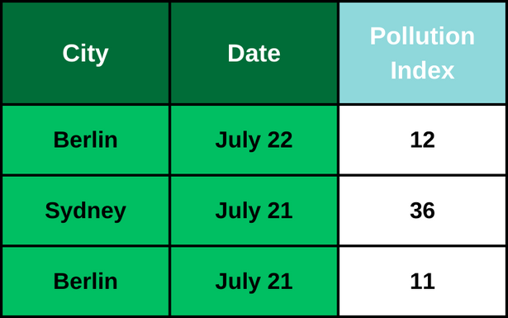
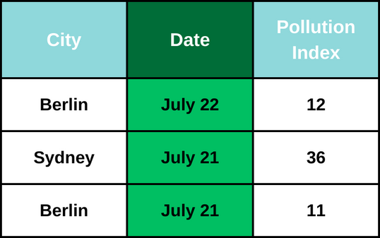
Composite (Multi-Attribute) Keys - Unary Join Search
Unary Join Search
700K Tables
On averafe 1000x False Positives
Unary Join Search
4M Tables

Slide 7
Composite (Multi-Attribute Keys) - Multi-Attribute Inverted Index
Table12
City | District | Date | Year | Pollution Index
Berlin | Kreuzberg | July 22 | 2022 | 12
Sydney | Inner West | July 21 | 2022 | 36
Berlin | Mitte | July 21 | 2022 | 11
C1 | C2 | C3 | C4 | C5
 | 2022 | July 21 | Sydney | Inner West
Sydney | Inner West | July 21 | 2022
Multi - Attribute Inverted Index
(“Sydney” , “Inner West” , “July 21” ,”2022” , “36”) ->{(Table12,Column 4 & 5 & 3 & 2, ROW 1),...}

Slide 8
Query Table
Candidate Join Table 12
City | District | Date | Year | Pollution Index
Berlin | Kreuzberg | July 22 | 2022 | 12
Sydney | Inner West | July 21 | 2022 | 36
Berlin | Mitte | July 21 | 2022 | 11
C1 | C2 | C3 | C4 | C5 | C6
2022 | Inner West |  | Sydney |  | July 21
r1
r2
r3
r4
Oracle
Table12,Row1

Slide 9
City | District | Date | Year | Pollution Index
Berlin | Kreuzberg | July 22 | 2022 | 12
Sydney | Inner West | July 21 | 2022 | 36
Berlin | Mitte | July 21 | 2022 | 11
1. Low Storage Complexity
2. Multi-Attribute Effectiveness
Sydney
3. Key Size Independence
Single-Attribute Inverted Index
“Sydney” -> {table12, Column 3 , Row 1, Oracle,...}

Slide 10
Mate
Super Key
Data Lake
Contry | City | Event | Date | Address
Usa | Chicago | BlackFriday | Dec 24 | ABC
XASH()
H1
+
H2
+
H3
+
H4
+
H5
SuperKey(SK)

Slide 11
EXAMPLE
Contry | City | Event | Date | Address
Usa | Chicago | BlackFriday | Dec 24 | ABC
XASH()
01001000
+
11000001
+
+
+
00001010
10000001
00000011
11001011

Slide 12
Querying The Super Key
Example
Berlin | July21
Berlin | July21
XASH()
XASH()
11000001
+
10000001
H(Berlin)
+
H(July21)
11011111

Slide 13
Xash(Goal)
How to generate Hash values
1) Value -> Hash
2) Minimum number of 1 bits
0100110100011001
1010010001011010
0011100110101100
1111110111111111
+
Hash(City) != Hash(Date)
Hash(City) ^ Hash(Date) ~ 0

Slide 14
1) Rare Characters
City | Date
Sydney | May 21
D
E
N
S
sydney -> 0000010010100000010
M
Y
1
may 21 -> 1010000000000101100
2) Characters Positions
R
City | Date
Berlin | December 31
Left 0 | Middle 1 | Right 0
Berlin
Left 0 | Middle 0 | Right 1
December
3) Value Length
Length
Character Features
City | Date
Amsterdam | September 31
Amsterdam
0010000000000101100
Length 9
September 31
0000010000000101100
Length 11

Slide 15

MATE ALGORITHM
Initialization
Fetching Candidate Tables
Iterating Over Candidate Tables
Filtering Based on PL Items
PL Item Matching
Superkey Matching and Joinability Score
Finalization

Slide 16

Conclusion
https://github.com/LUH-DBS/MATE
Check out the Git Repository!
MATE , a multi-attribute join discovery system
XASH efficiently encodes syntactic features
Enhanced inverted index for multi-column processing
Compatible with traditional filtering, e.g., prefix filter

Slide 17


